Slide 1

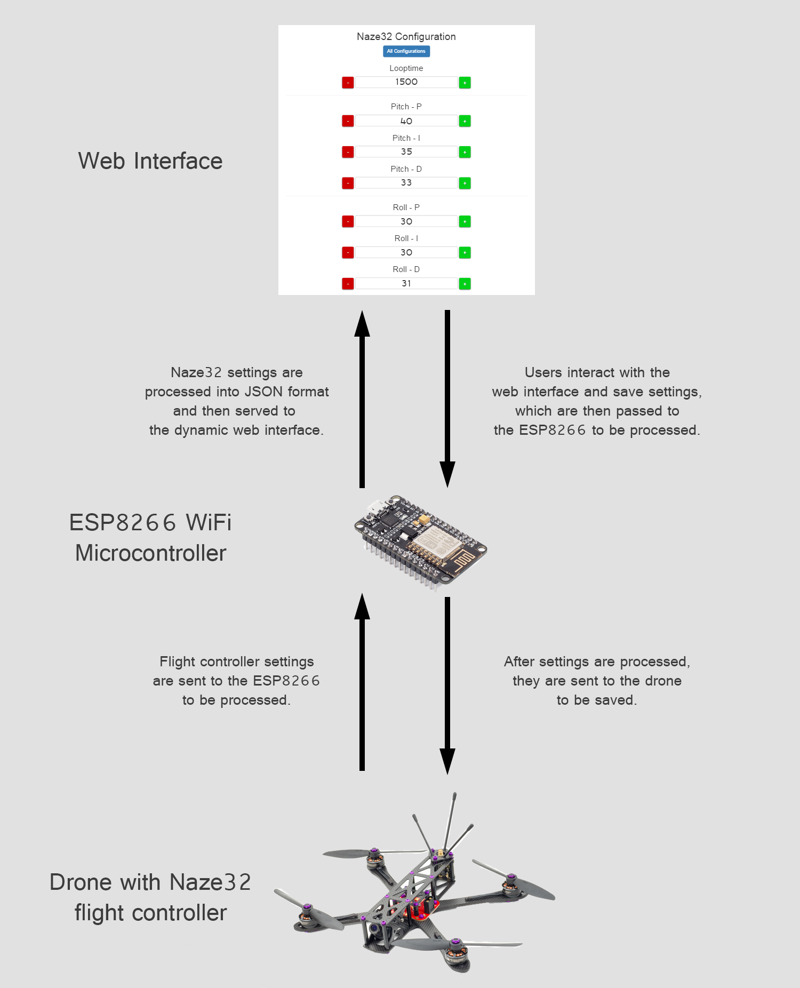
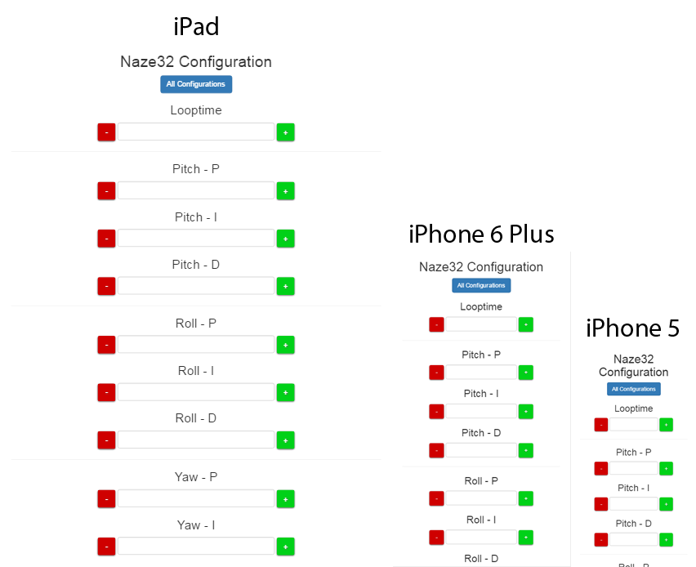
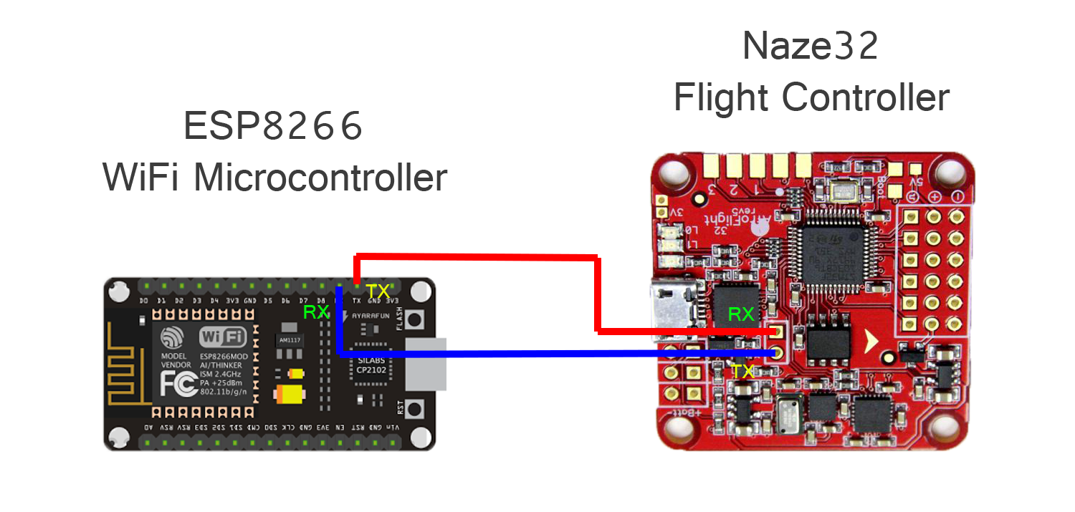
Configuring a Drone Flight Controller over WiFi
Mitchell Gerber
Computer Science Department
Advisor: Dr. Joan Francioni
Introduction
Radio controlled multirotors or “drones” are all controlled by some sort of flight controller. The flight controller involved in this project is the Naze32, which is commonly used in small racing drones. The Naze32 flight controller must be configured by a desktop application called the Cleanflight Configurator. The problem is that a desktop computer may not always be accessible while out in the field operating the drone.
The primary focus of this project is to develop a system that enables WiFi configuration of the Naze32 flight controller. The ESP8266 WiFi microcontroller is used to interface with the drone flight controller to enable wireless connectivity. This solves the problem of having limited access to a desktop computer by enabling configuration with mobile devices capable of WiFi.
Results
Development and testing has proven that WiFi configuration of the Naze32 drone flight controller is a possibility. Access to configuration settings of the drone is quicker and easier by using a mobile device.
Testing has concluded that the ESP8266 is capable of serving web pages under 35kb in size.
Responsive of the web interface was tested with the Google Chrome mobile device simulator. The web interface was consistent across a wide array of devices.
Figure 2: Configuration Process
Figure 3: Responsive Design
Figure 1: Serial Communication
Method
Establish communication between the Naze32 flight controller and the ESP8266 microcontroller using the Serial Communication Protocol.
Parse Naze32 settings into Javascript Object Notation format to be sent to the client side.
Develop a responsive user interface that is consistent across a wide array of devices that vary in screen resolutions.
Perform tests on web pages served by the ESP8266.
Conclusion
Throughout the process of development and testing I learned that working with microcontrollers can be finicky. Dealing with size constraints and serial communication requires very careful attention to detail in program structure. Future development may include adding more features to the user interface such as real time telemetry data.
Hypothesis
Features of the Cleanflight Configurator can be implemented on the ESP8266 microcontroller, which can then be used to configure the Naze32 flight controller wirelessly over a WiFi network.

